Slide 1
Working with Disks and Devices
Lesson 4

Slide 2
Understanding Partition Styles
MBR – Master Boot Record
GPT – GUID (globally unique identifier) Partition Table
Notes:
Introduce the partition styles. Which OS’s support each one. Don’t go through details here. Use the chart on the next slide.

Slide 3
Partition Style Comparison
MBR
GPT
Supports up to 4 primary partitions, or 3 primary and an extended
Supports volumes up to 2 terabytes
Uses hidden sectors to store system information
Replication and CRC are NOT features of MBR’s partition table
Supports up to 128 primary partitions
Supports volumes up to 18 exabytes*
Uses partitions to store system information
Replication and cyclical redundancy check (CRC) protection of the partition table for reliability
*1 EB = 1,000,000,000,000,000,000B = 10¹⁸ bytes = 1,000,000,000gigabytes = 1,000,000 terabytes
Notes:
Compare the different Partition Styles.

Slide 4
Disk Types – Basic Disk
Compatible with other versions of Windows
Consists of primary and extended partitions
Supports up to four partitions (per single hard drive)
Windows can only be installed on basic storage type partitions

Slide 5
Primary and Extended Partitions
PRIMARY
EXTENDED
Functions as a physically separate disk
Can host an OS
Can be marked as active (and used to boot from)
Up to 4 are supported or 3 + 1 extended
Each is formatted and assigned a drive letter
Cannot host an OS
Cannot be active partition
Basic disk can only host 1 Extended but unlimited logical partitions
Do not format extended partition, but only the logical drives
Notes:
Compare Primary and Extended partition properties and give examples of when you would use each. Discuss possible disk configurations.

Slide 6
Disk Types – Dynamic Disks
Supported by Windows 2000/XP/Vista/7
Can combine two or more physical disks into one dynamic disk
Are divided into volumes
Unlimited number of volumes
Not supported on:
Portable computers
Removable disks
External USB or Firewire Drives
Windows 7 Starter or Home editions

Slide 7
Volume Types
Simple volume
Spanned volume
Striped volume
Mirrored volume
Notes:
Introduce the 4 volume types. You can mention RAID 5, but note that Windows 7 doesn’t support it.

Slide 8
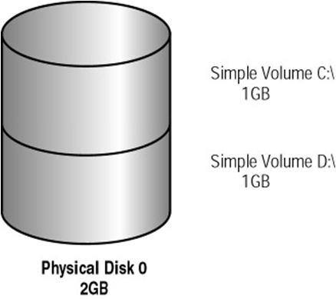
Dynamic Disk - Simple Volume
Contains space from a single dynamic drive

Slide 9
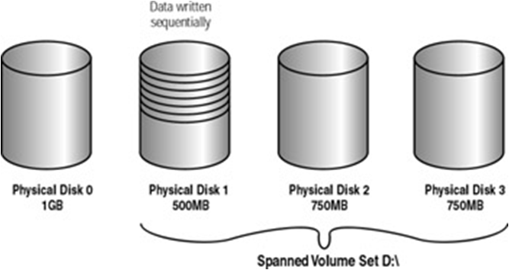
Dynamic Disk - Spanned Volume
Consists of disk space on 2 to 32 dynamic drives (any size)
Notes:
Explain Spanned Volume’s requirements and limitations. Make sure to mention that the areas of free space being combined can be any size. Explain how data is written to the areas of space within a spanned volume. Mention that there is no parity information stored in a spanned volume and that backups are important.

Slide 10
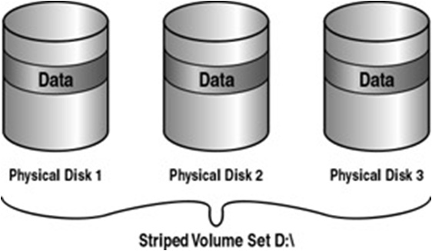
Dynamic Disk - Striped Volume
stores data in equal stripes on 2 - 32 dynamic drives (same size)
Notes:
Explain Striped Volume’s requirements and limitations. Make sure to mention that the areas of free space being combined must be the same size and there is no parity information.

Slide 11
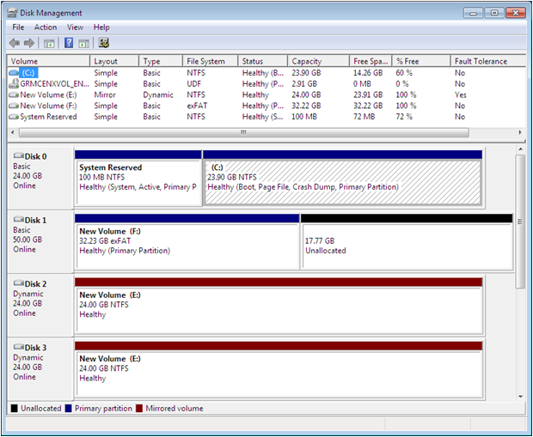
Dynamic Disk – Mirrored Volume
Notes:
Explain what the purpose of mirroring is and its requirements.

Slide 12
File Systems
NTFS
Preferred file system for Windows 7
Partitions up to 4 TB
Security (encryption and permissions)
FAT (FAT16) – Partitions up to 4 GB
FAT32 – Partitions up to 32 GB (Windows 7 limitation)
exFAT (FAT64) – Intended for large USB drives, not hard drives
Notes:
Describe each file system, its limitations, and when you might use each one. Discuss the benefits of NTFS and why it is the preferred file system for Windows 7.

Slide 13
Using the Disk Management Snap-In
Initializing disks
Selecting a partition style
Converting basic disks to dynamic disks
Creating partitions and volumes
Extending, shrinking, and deleting volumes
Formatting partitions and volumes
Assigning and changing driver letters and paths
Examining and managing physical disk properties such as disk quotas, folder sharing, and error checking
Notes:
Describe the different tasks you can perform with the Disk Management tool. Demonstrate if you can. Continued on next slide.

Slide 14
Using Disk Tools
Disk Cleanup
Defragmenting disks
Checking for disk errors
Notes:
Explain that these tools are available in the Disk Management Snap in, by using the context-sensitive menus. Describe each tool and when you need to use it.

Slide 15
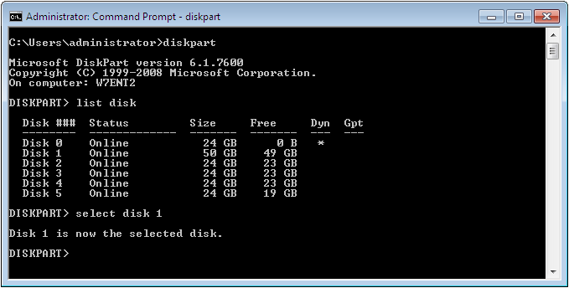
Diskpart.exe
Notes:
Explain that DiskPart is a command line tool which can be used to manage disks. It is more powerful than the Disk Management Snap in. You can do more and different tasks with it.

Slide 16
Your Tasks
Do LAB 5 and LAB 6 (Complete LAB sheets and email to dtorsney@west-lothian.ac.uk)
Do Lesson 4 Knowledge Assessment (Fill in the Blank and True/False) Page 144

